Slide 1
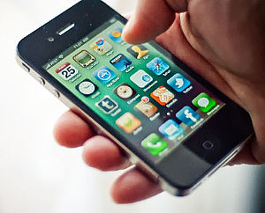
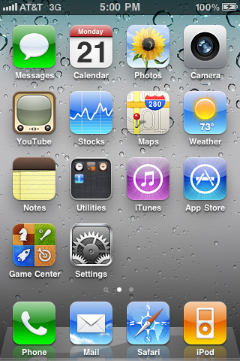

Slide 2
Short History of Mobile Web
1996: First access to mobile web (Finland) on Nokia 9000 Communicator
1999: First commercial launch of a mobile-specific browser-based web service (Japan)
2007: iPhone unveiled
2008: Mobile access (mobile web) to the Internet exceeded desktop computer-based access for the first time (source: ITU)
2008: Apple launches App Store
2009 (April) : 1 billion app downloads from App store
2010 (April): 4 billion app downloads
2011 (March): Apple sells 100 millionth iPhone
2011: 350,000+ apps in App Store

Slide 3
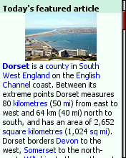
From Mobile Web to Apps
Wikipedia on the Mobile Web

Slide 4
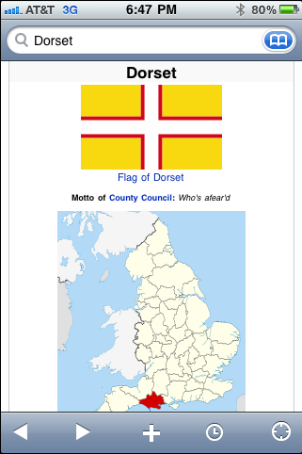
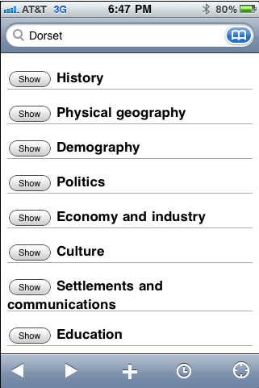
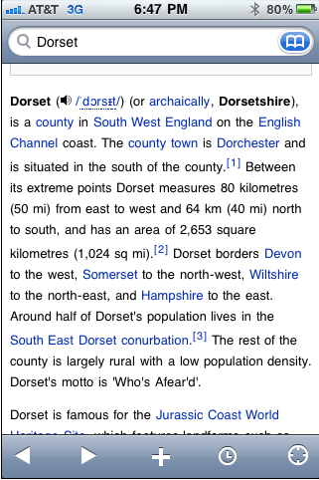
Wikipedia – App version

Slide 5
App Magic?

Slide 6
Enhanced
User Experience

Slide 7
User Experience
Design
Features
Functions
Performance

Slide 8
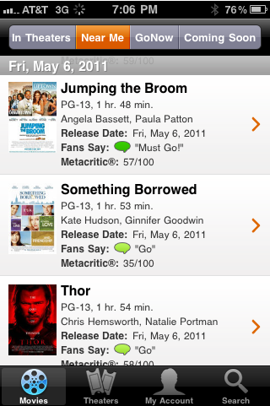
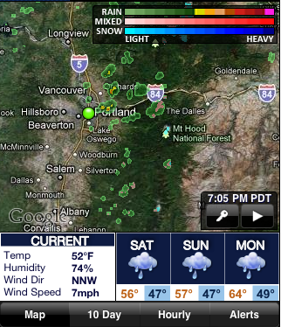
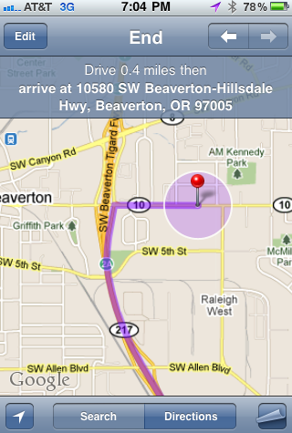
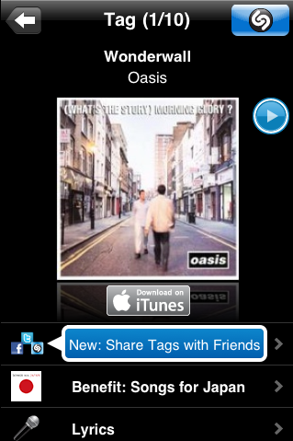
User Experience
Design
Features
Functions
Performance

Slide 9
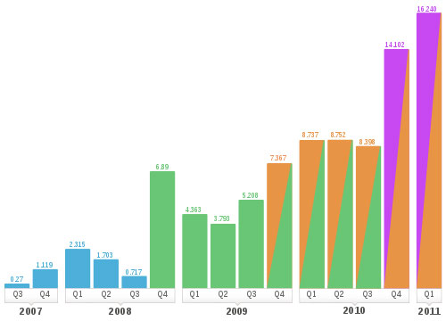

iPhone Sales per Quarter
(millions sold)

Slide 10


Slide 11
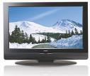
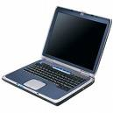
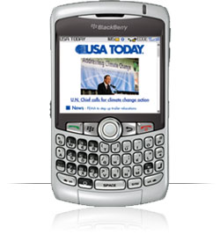
Three screens
Television Web Mobile
KGW MEDIA GROUP
Local News & Information:
Anywhere, any time

Slide 12
300% YTY Mobile PV growth

Slide 13
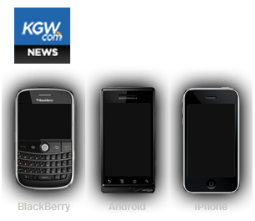
App Downloads
iPhone downloads
June-Nov: 17,500
11/17 (3 wks): 9,800
Android downloads
11/17 (3 wks): 3,000

Slide 14
Mobile PVs by section

Slide 15
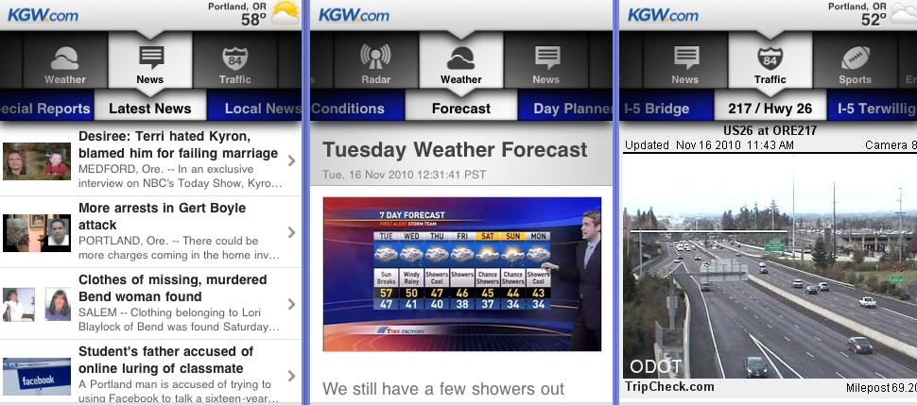
KGW.com News app
2.0 version launched Nov 2010
40,000 app downloads in 6 months

Slide 16
KGW.com Mobile Page Views
Averaging 400 % YTY monthly page view growth

Slide 17
Mobile share of Web
Mobile - 1%
Mobile - 4%
Mobile - 12%
March 2011 – Mobile reached 20% of KGW.com page views

Slide 18
Mobile PV by device
60% of KGW.com Mobile PVs by iPhone owners (25% of market)
Users with an APP consume 6 x more than mobile web users

Slide 19
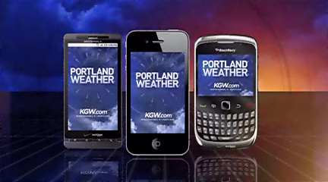
KGW launches “Portland Weather”

Slide 20
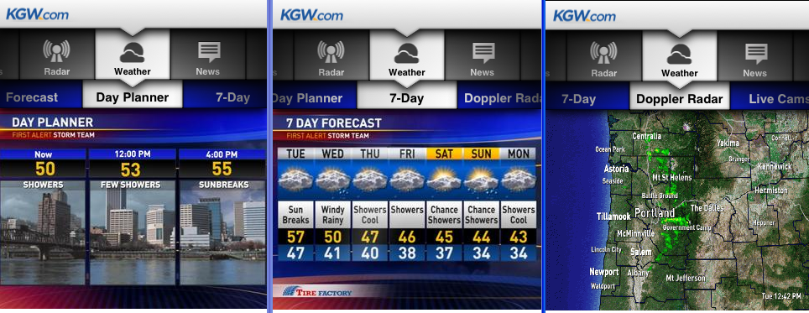
“Portland Weather”
Launched March 13, 2011
4,000 app downloads in 6 weeks

Slide 22
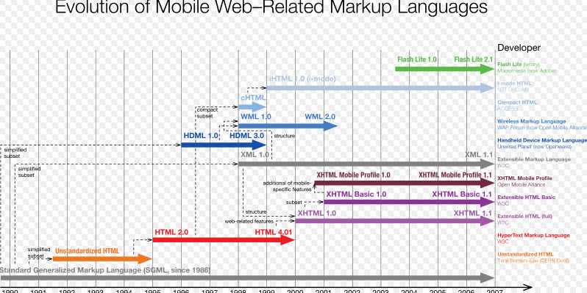

Slide 23

Frank Mungeam
Since 1998: Digital Media Manager
15 yrs as TV Producer & Executive Producer
Psychology degree from Harvard; MA communications, Gonzaga
Director of Digital Media
KGW NewsChannel 8

Slide 24
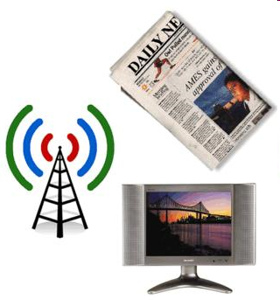

Slide 25



Slide 26
KGW Digital Strategy:
From ‘TV’ to ‘Media Group’

Slide 27
Three screens
Television Web Mobile
KGW MEDIA GROUP
Local News & Information:
Anywhere, any time

Slide 28


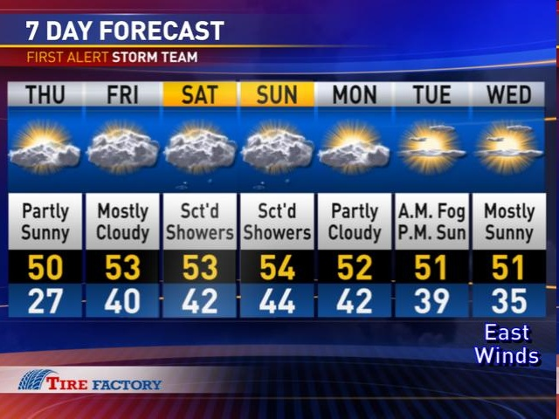
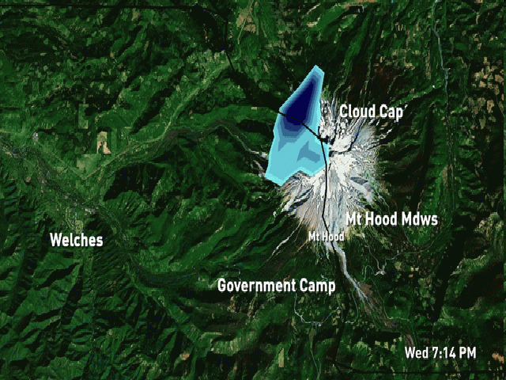
Breaking News
Video on Demand
Latest Forecast
Live Doppler Radar

Slide 29
KGW.com News app
2.0 version launched Nov 2010
40,000 app downloads in 6 months

Slide 30
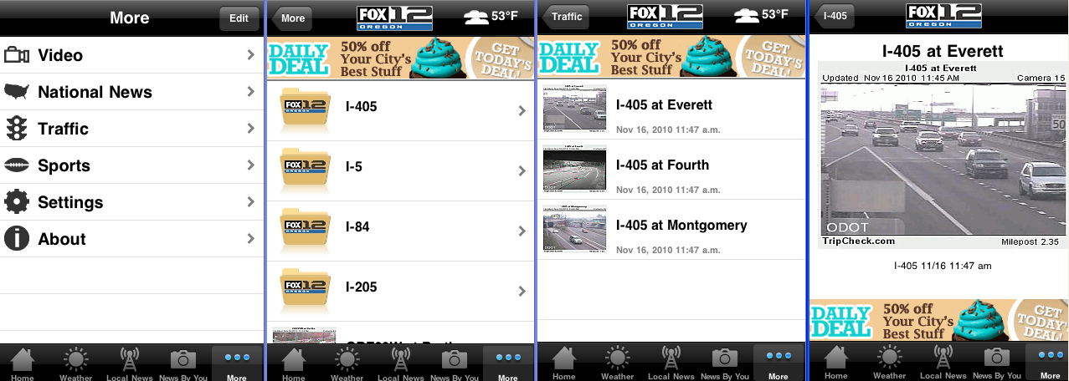
Traffic

Slide 31
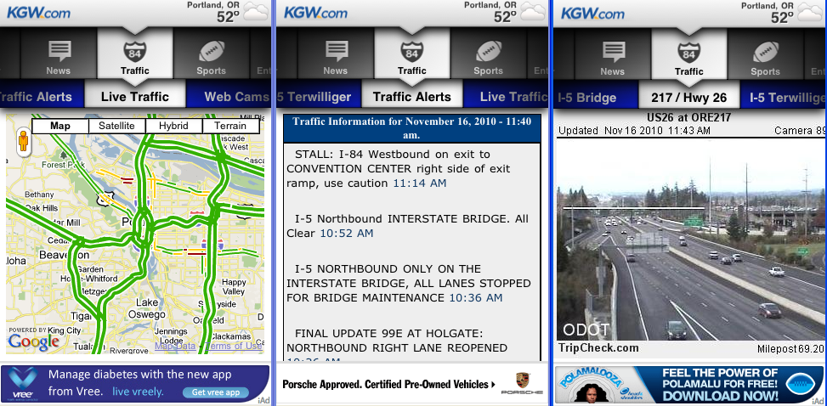
Traffic
Real-time Google traffic flow
Real-time Traffic Alerts
12 ODOT cams (more to come)

Slide 32
KGW launches “Portland Weather”

Slide 33
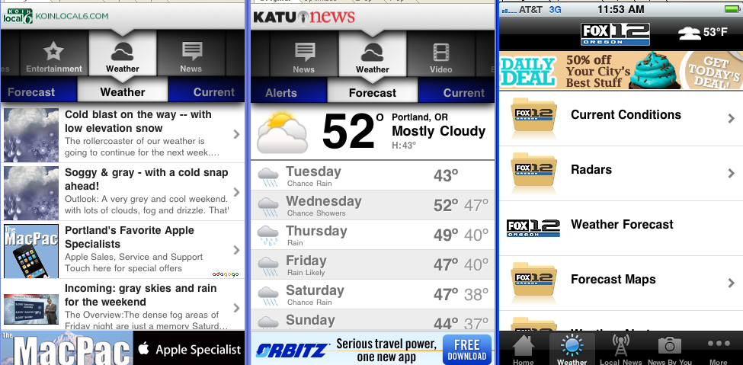
Weather

Slide 34
“Portland Weather”
Launched March 13, 2011
4,000 app downloads in 6 weeks

Slide 35
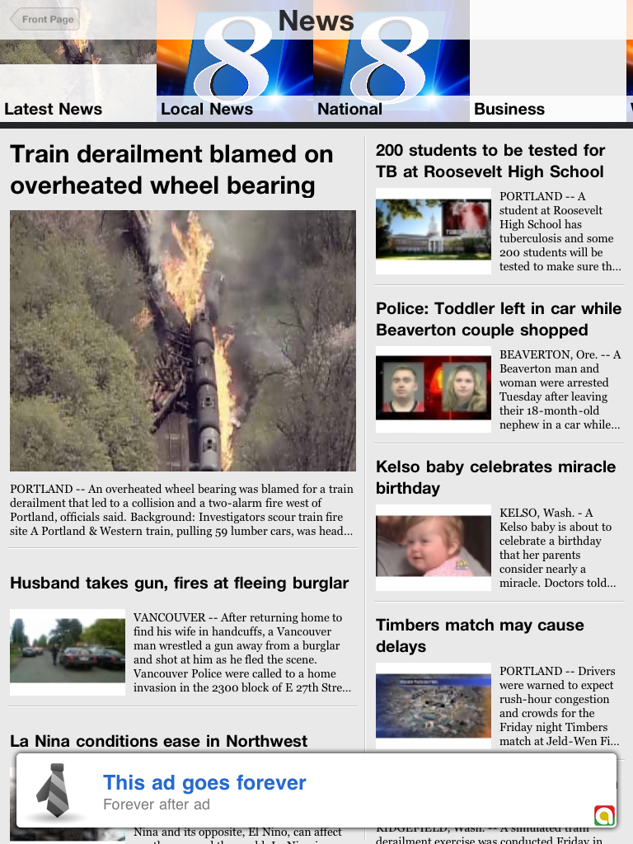

Slide 36
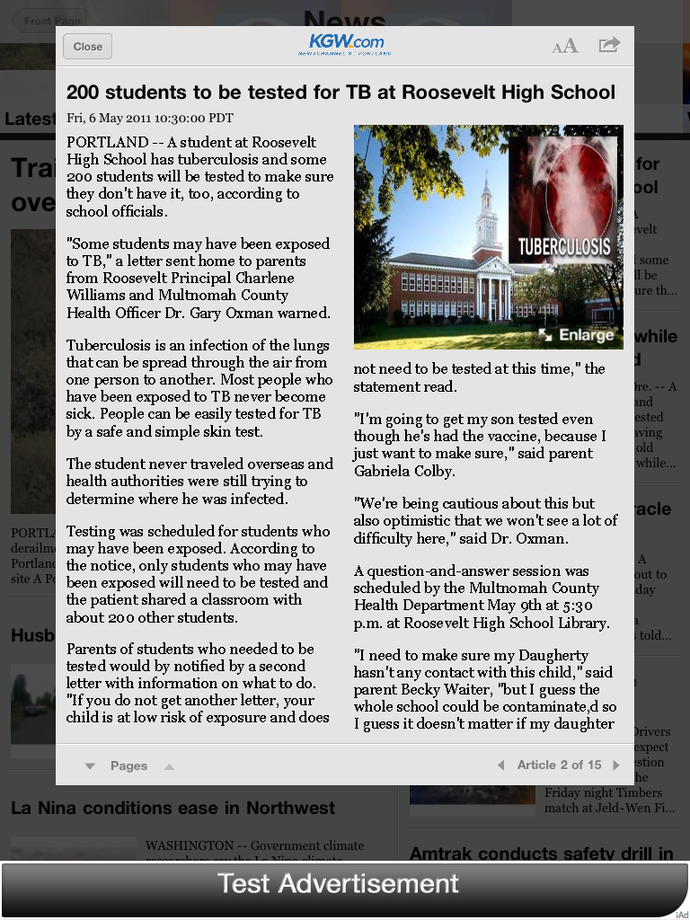

Slide 37



8,000 Fans
10,000 Followers

